Slide 1



VG Analysis
View in Power BI
Last data refresh:
8/15/2023 8:03:50 PM UTC
Downloaded at:
8/15/2023 11:56:31 PM UTC

Slide 2
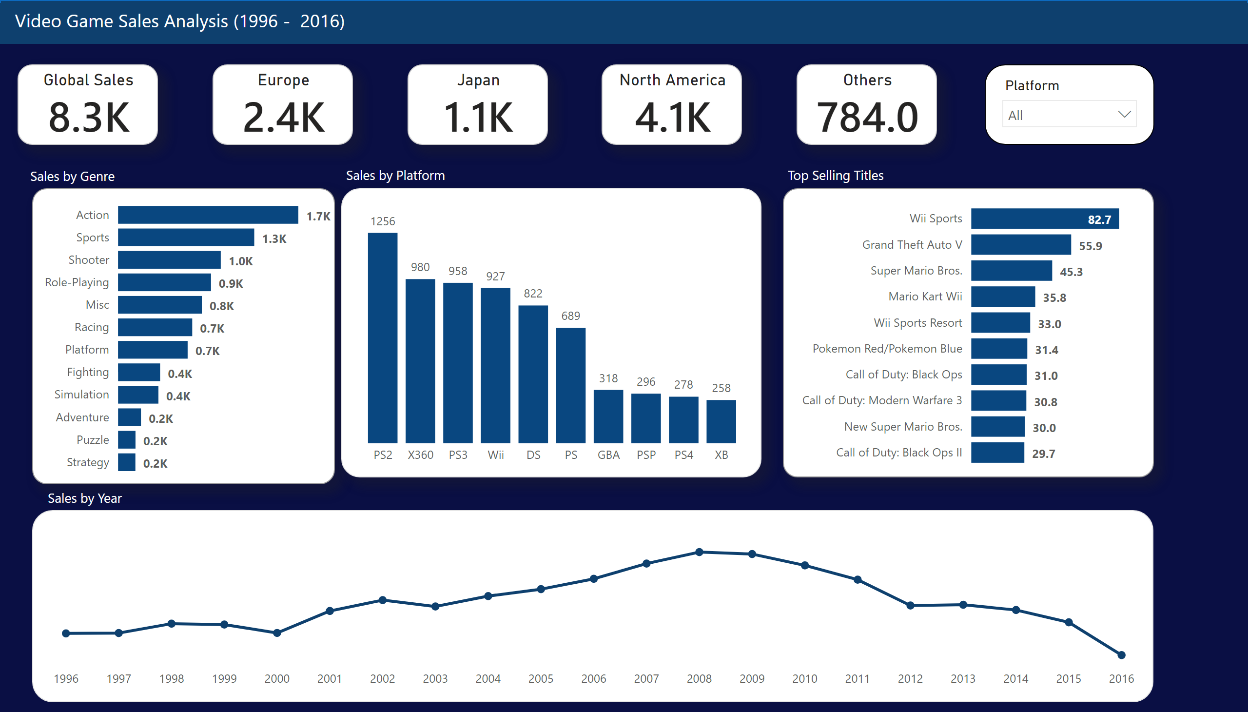
Video Game Sales Report
Notes:
Global Sales
No alt text provided
Global Sales by Genre
No alt text provided
Top 10 Global Sales by Title
No alt text provided
columnChart
No alt text provided
slicer
No alt text provided
textbox
No alt text provided
textbox
No alt text provided
shape
No alt text provided
lineChart
No alt text provided
Europe
No alt text provided
Japan
No alt text provided
North America
No alt text provided
Others
No alt text provided
textbox
No alt text provided
textbox
No alt text provided
textbox
No alt text provided

Slide 3
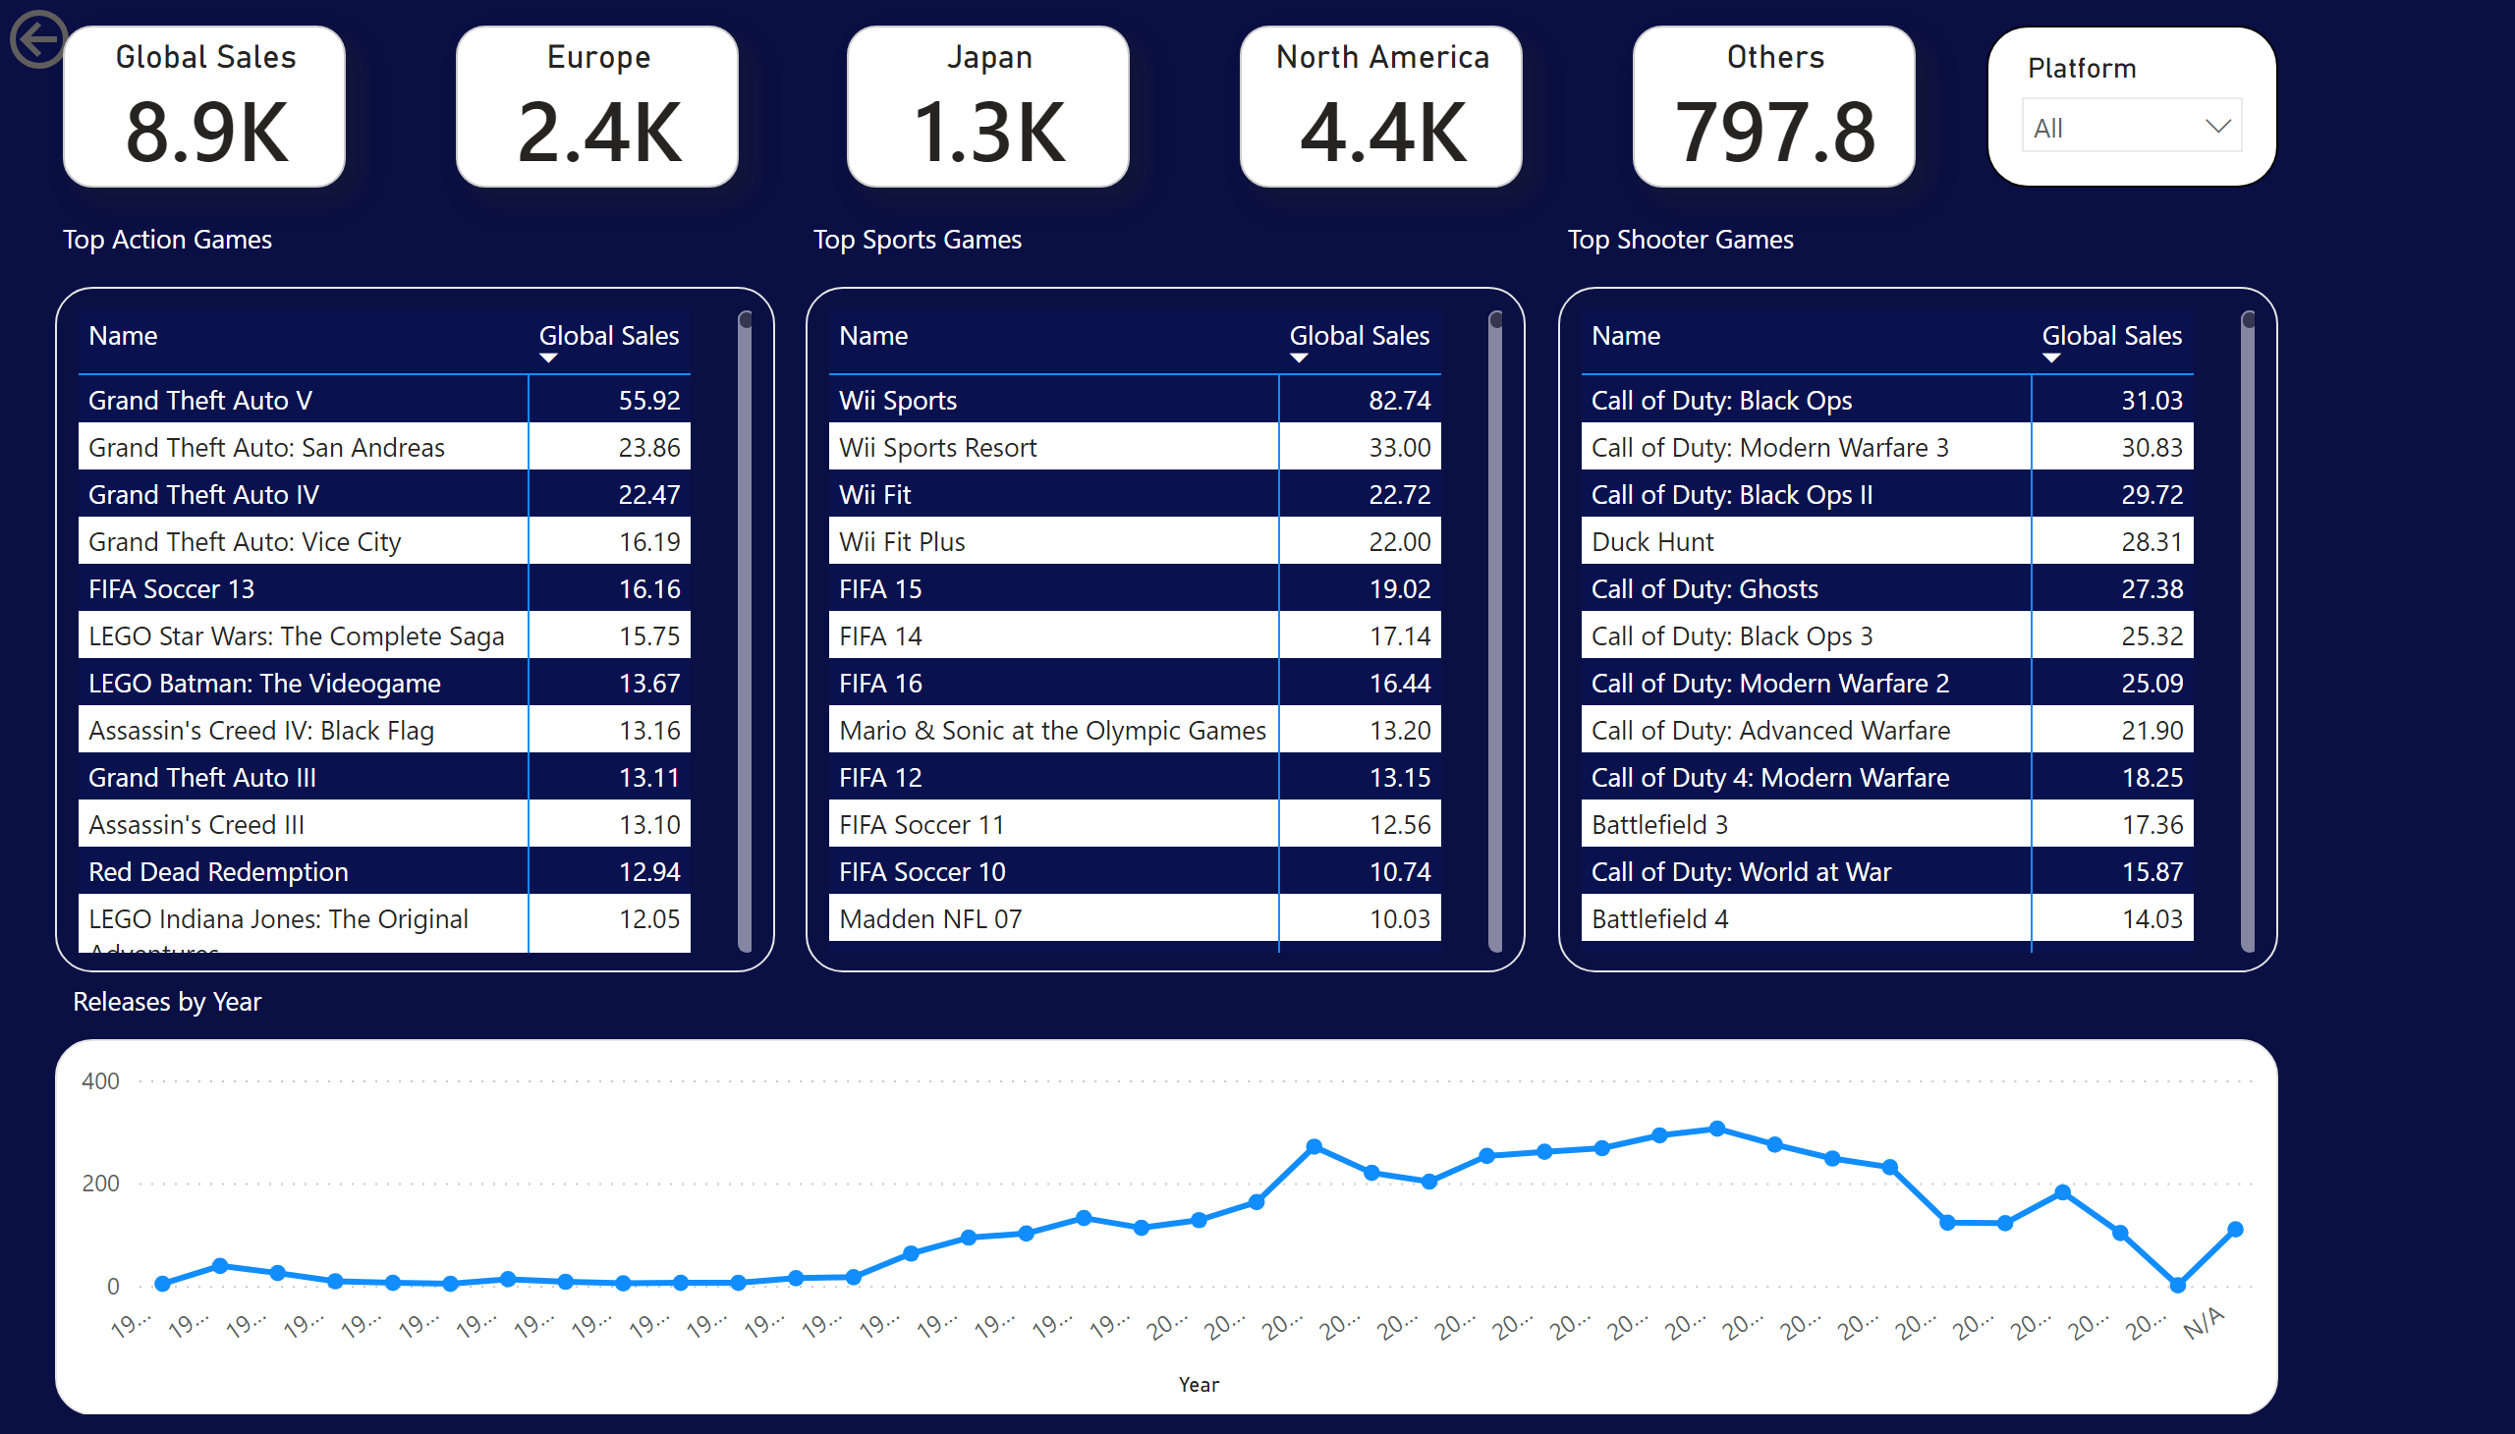
Top Genre Breakdown
Notes:
actionButton
No alt text provided
pivotTable
No alt text provided
textbox
No alt text provided
pivotTable
No alt text provided
pivotTable
No alt text provided
textbox
No alt text provided
textbox
No alt text provided
Global Sales
No alt text provided
slicer
No alt text provided
Europe
No alt text provided
Japan
No alt text provided
North America
No alt text provided
Others
No alt text provided
lineChart
No alt text provided
textbox
No alt text provided

Slide 4
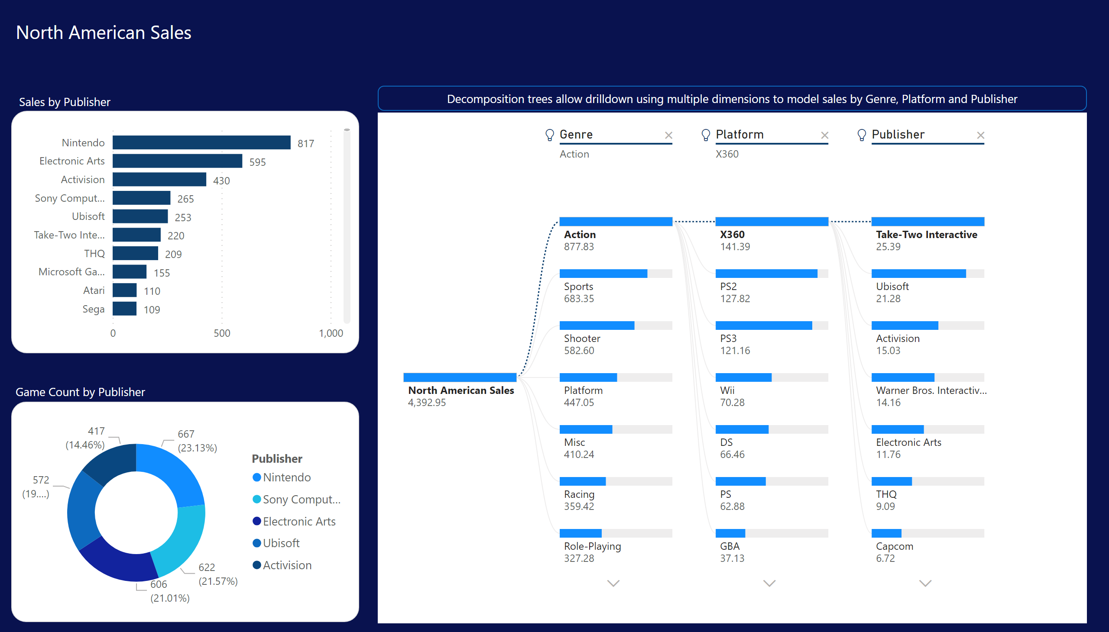
North American Sales Analysis
Notes:
barChart
No alt text provided
donutChart
No alt text provided
textbox
No alt text provided
textbox
No alt text provided
decompositionTreeVisual
No alt text provided
shape
No alt text provided
textbox
No alt text provided

Slide 5
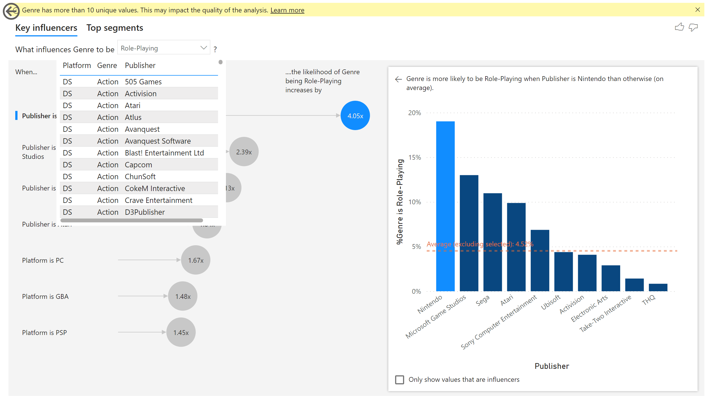
Key Influencers
Notes:
keyDriversVisual
No alt text provided
tableEx
No alt text provided
actionButton
No alt text provided

